Slide 1
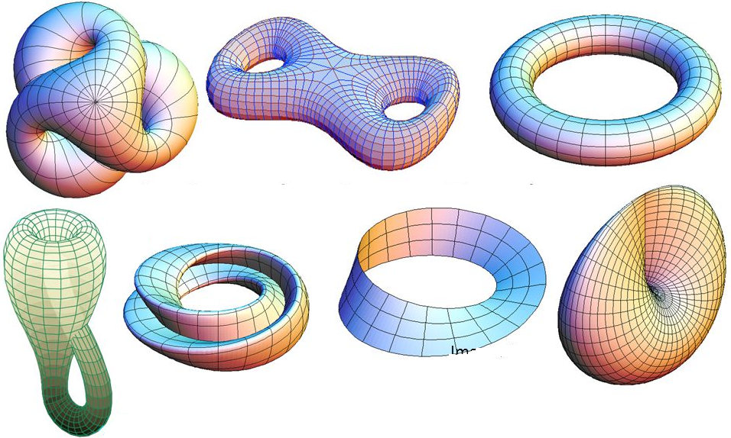
Topology Introduction

Slide 2

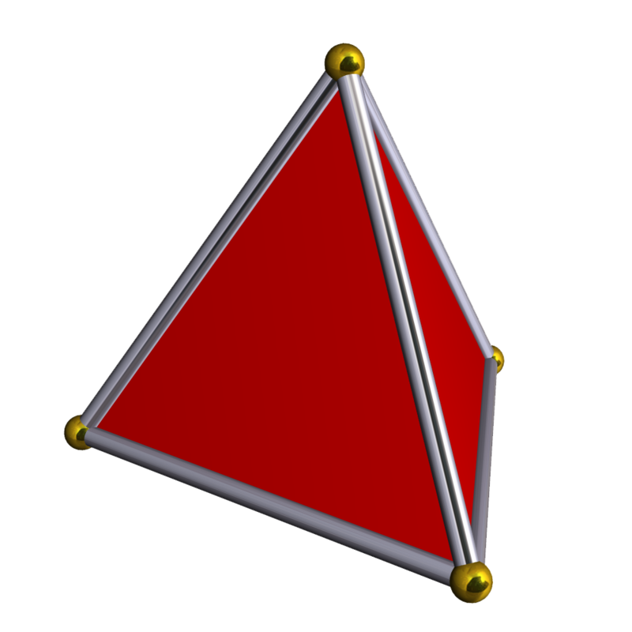
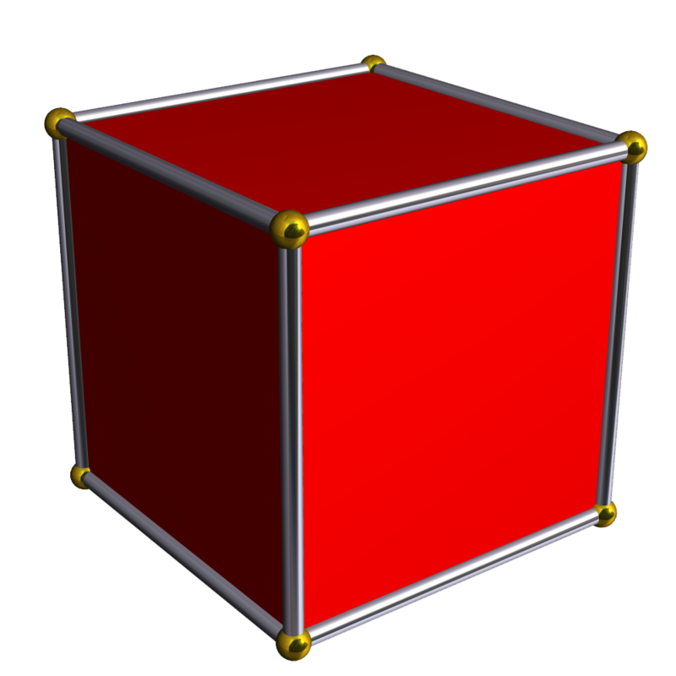
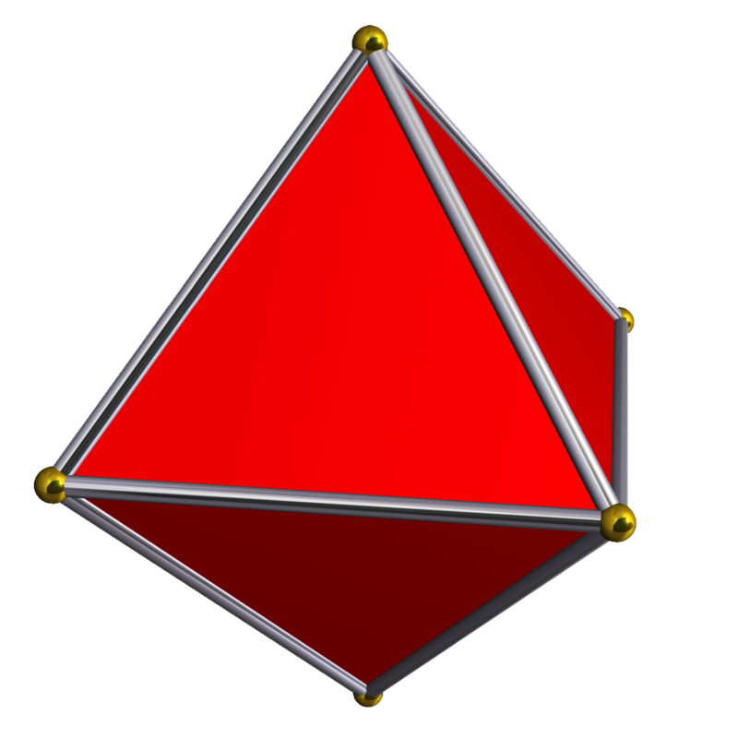
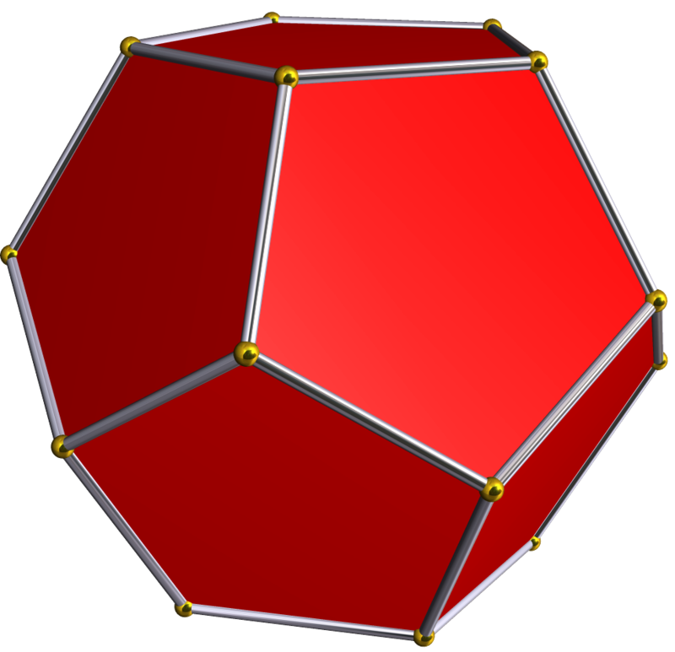
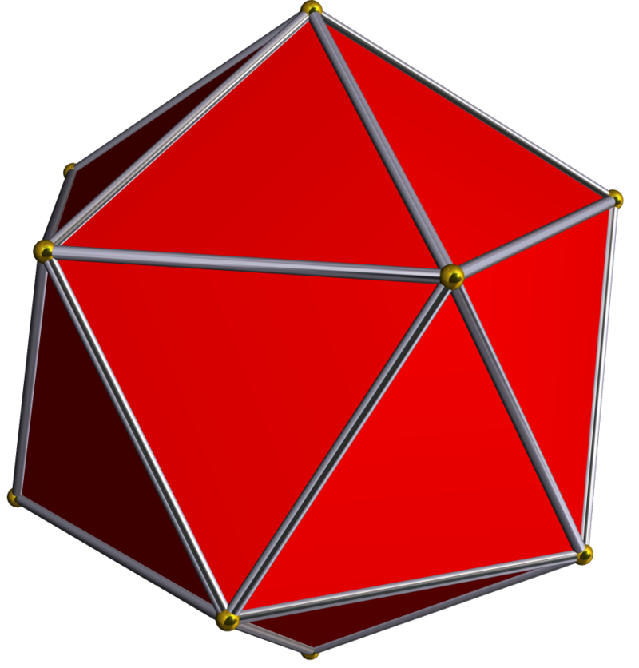
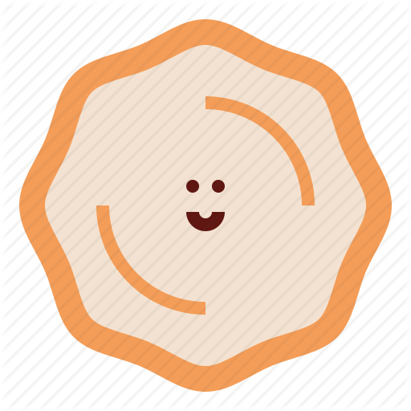

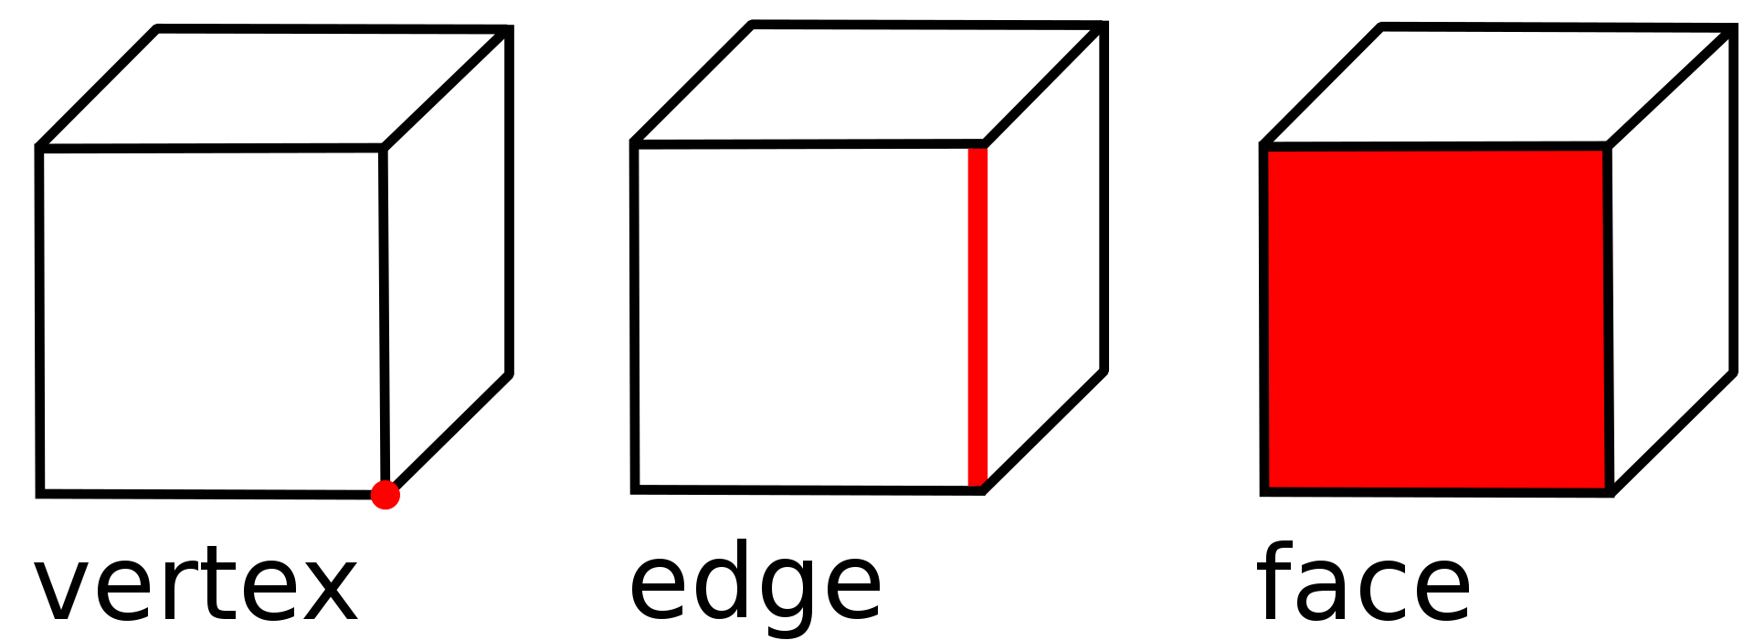

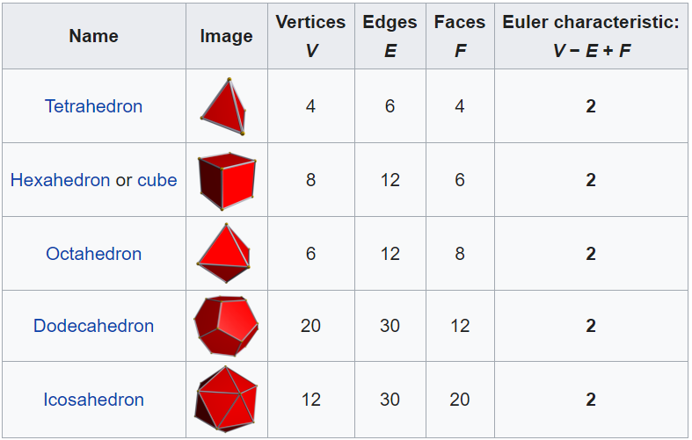
DO YOU THINK THEY ARE “SAME” IN SOME WAY?
Could you please find anything common in these forms?
Tetrahedron
Hexahedron or cube
Octahedron
Dodecahedron
Icosahedron

Slide 3

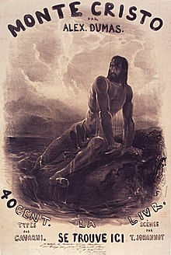

COMPARE EVERYWHERE?
Comparative literature is an academic field dealing with the study of literature and cultural expression across linguistic, national, geographic, and disciplinary boundaries. Comparative literature "performs a role similar to that of the study of international relations, but works with languages and artistic traditions, so as to understand cultures 'from the inside'"
In the The Count of Monte Cristo (French: Le Comte de Monte-Cristo) an adventure novel written by French author Alexandre Dumas (père) completed in 1844, how to think Edmond Dantès felt very regretful to his revenge in the end of the book?
Poem: Bullet (Sanders Wang)
Bullet hit Bird
Bird cries, for he could not fly
Bullet also, for he could not fly
COULD YOU FIND ANYTHING COMMON?

Slide 4
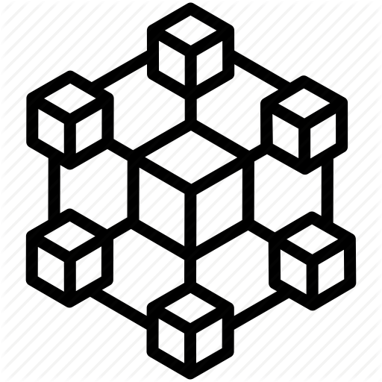
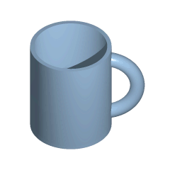
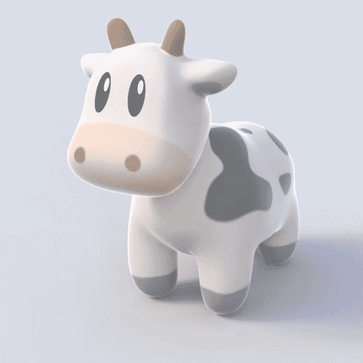
WHAT IS TOPOLOGY
In mathematics, topology (from the Greek words τόπος, 'place, location', and λόγος, 'study') is concerned with the properties of a geometric object that are preserved under continuous deformations, such as stretching, twisting, crumpling, and bending; that is, without closing holes, opening holes, tearing, gluing, or passing through itself.
The motivating insight behind topology is that some geometric problems depend not on the exact shape of the objects involved, but rather on the way they are put together. For example, the square and the circle have many properties in common: they are both one dimensional objects (from a topological point of view) and both separate the plane into two parts, the part inside and the part outside.
A continuous deformation (a type of homeomorphism) of a mug into a doughnut (torus) and a cow into a sphere

Slide 5


WHAT IS TOPOLOGY
Topology only has global structure, and studies more general properties, e.g, connectivity and more.
Homeomorphism / Homotopy equivalence
continuous deformations, such as stretching, twisting, crumpling, and bending; that is, without closing holes, opening holes, tearing, gluing, or passing through itself.
Geometry focuses on the detailed forms or structures properties, e.g, surface area, volume, and more.

Slide 6

TOPOLOGY vs GEOMETRY
The properties of an object that stay the same when you bend, stretch or twist it are called the topology of the object. Two objects are considered the same topologically if you can deform one into the other without tearing, cutting, pinching, gluing, or other violent actions.
ABSTRACT
The properties of an object that change when you bend, stretch, or twist are the geometry of the object. For example, distances, angles, and curvature are parts of geometry but not topology.

Slide 7
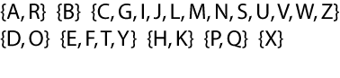
WHAT IS TOPOLOGY - Homeomorphism
Intuitively, two spaces are homeomorphic if one can be deformed into the other without cutting or gluing. A traditional joke is that a topologist cannot distinguish a coffee mug from a doughnut, since a sufficiently pliable doughnut could be reshaped to a coffee cup by creating a dimple and progressively enlarging it, while shrinking the hole into a handle.
Homeomorphism can be considered the most basic topological equivalence.
An introductory exercise is to classify the uppercase letters of the English alphabet according to homeomorphism.
Homeomorphism classes are:
no holes corresponding with C, G, I, J, L, M, N, S, U, V, W, and Z;
no holes and three tails corresponding with E, F, T, and Y;
no holes and four tails corresponding with X;
one hole and no tail corresponding with D and O;
one hole and one tail corresponding with P and Q;
one hole and two tails corresponding with A and R;
two holes and no tail corresponding with B;
a bar with four tails corresponding with H and K; the "bar" on the K is almost too short to see.

Slide 8
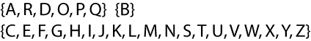
WHAT IS TOPOLOGY -Homotopy equivalence
Homotopy equivalence is harder to describe without getting technical, but the essential notion is that two objects are homotopy equivalent if they both result from "squishing" some larger object.
An introductory exercise is to classify the uppercase letters of the English alphabet according to homotopy equivalence.
Homotopy classes are larger, because the tails can be squished down to a point. They are:
one hole: A, R, D, O, P, Q;
two holes: B;
no holes: C, E, F, G, H, I, J, K, L, M, N, S, T, U, V, W, X, Y, Z.

Slide 9
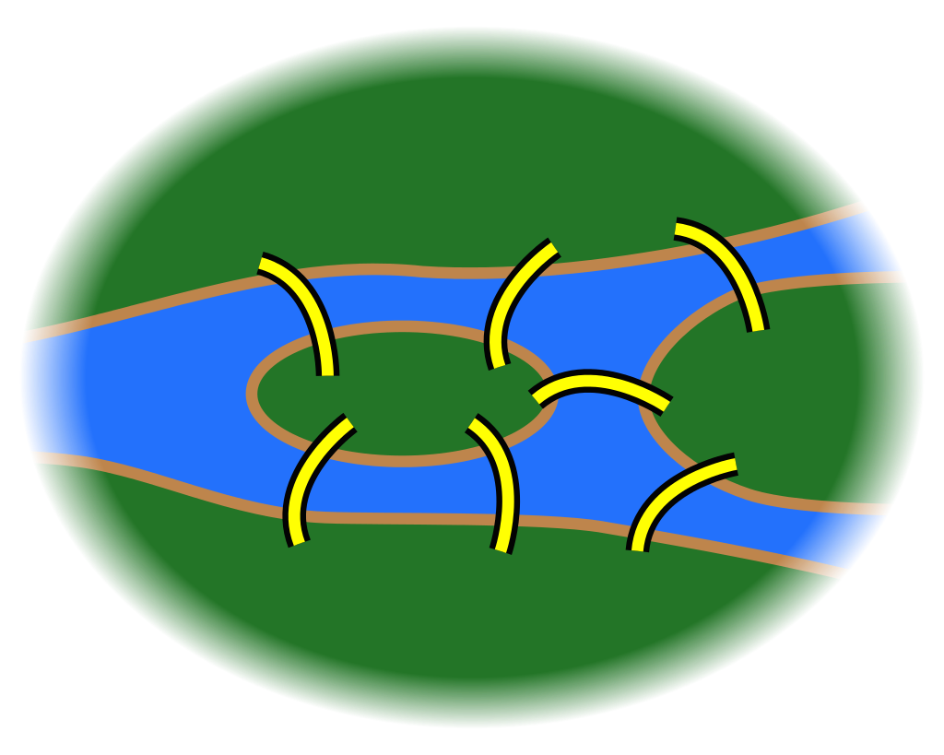

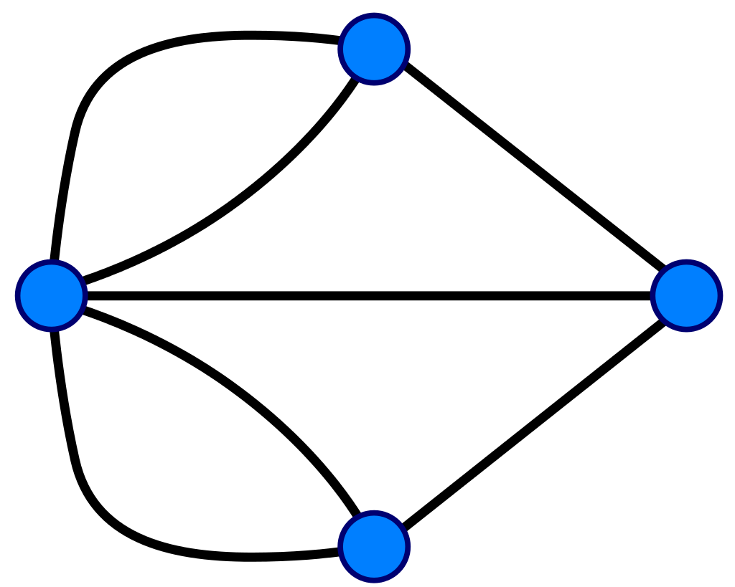
WHY NEEDS TOPOLOGY - Seven Bridges of Königsberg
The Seven Bridges of Königsberg is a historically notable problem in mathematics. Its negative resolution by Leonhard Euler in 1736^{[1]} laid the foundations of graph theory and prefigured the idea of topology.^{[2]}
The city of Königsberg in Prussia (now Kaliningrad, Russia) was set on both sides of the Pregel River, and included two large islands—Kneiphof and Lomse—which were connected to each other, or to the two mainland portions of the city, by seven bridges. The problem was to devise a walk through the city that would cross each of those bridges once and only once.
By way of specifying the logical task unambiguously, solutions involving either
reaching an island or mainland bank other than via one of the bridges, or
accessing any bridge without crossing to its other end
are explicitly unacceptable.
2
5
2
4
1
4
1
5
4
2
4
2
1
1
6
3
7
6
7
3
3
3

Slide 10
WHY NEEDS TOPOLOGY - Eulerian path
In graph theory, an Eulerian trail (or Eulerian path) is a trail in a finite graph that visits every edge exactly once (allowing for revisiting vertices). Similarly, an Eulerian circuit or Eulerian cycle is an Eulerian trail that starts and ends on the same vertex. They were first discussed by Leonhard Euler while solving the famous Seven Bridges of Königsberg problem in 1736.
An undirected graph has an Eulerian cycle if and only if every vertex has even degree, and all of its vertices with nonzero degree belong to a single connected component.
An undirected graph can be decomposed into edge-disjoint cycles if and only if all of its vertices have even degree. So, a graph has an Eulerian cycle if and only if it can be decomposed into edge-disjoint cycles and its nonzero-degree vertices belong to a single connected component.
An undirected graph has an Eulerian trail if and only if exactly zero or two vertices have odd degree, and all of its vertices with nonzero degree belong to a single connected component.
5
2
E(V1)=3, V1 is odd degreed vertex
E(V2)=3, V2 is odd degreed vertex
E(V3)=3, V3 is odd degreed vertex
E(V4)=4, V4 is even degreed vertex
There are 3 odd degreed vertices, so no Eulerian trail.
4
1
4
2
1
6
3
7
3

Slide 11
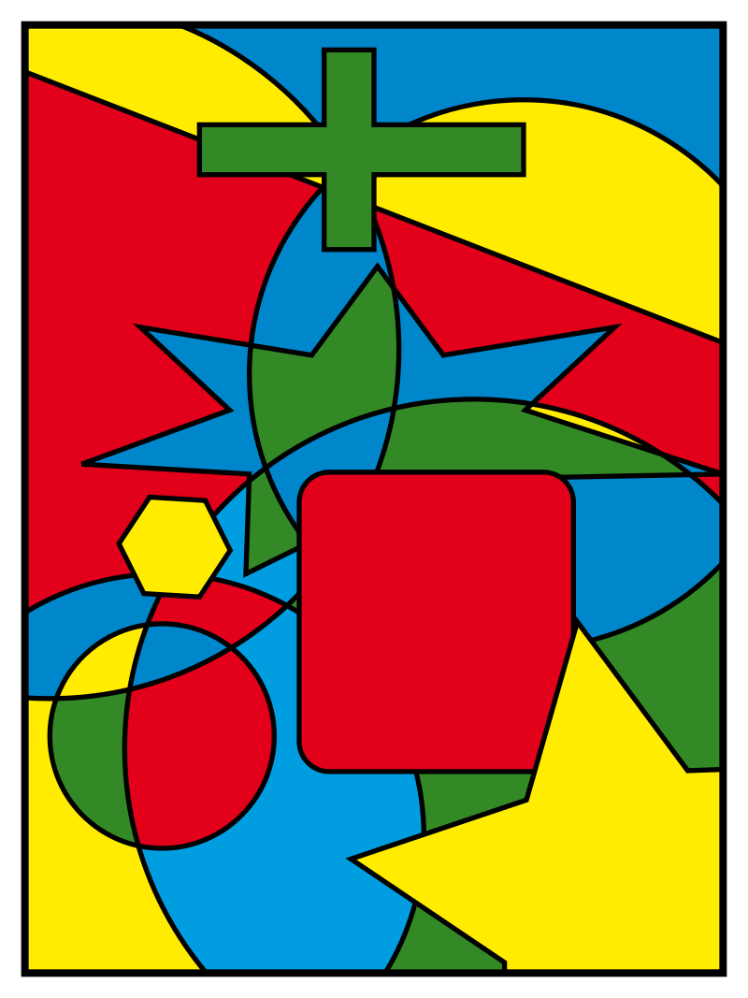
WHY NEEDS TOPOLOGY -Four color theorem (Fyrfärgssatsen)
In mathematics, the four color theorem, or the four color map theorem, states that, given any separation of a plane into contiguous regions, producing a figure called a map, no more than four colors are required to color the regions of the map so that no two adjacent regions have the same color. Adjacent means that two regions share a common boundary curve segment, not merely a corner where three or more regions meet. It was the first major theorem to be proved using a computer.
A simpler statement of the theorem uses graph theory. The set of regions of a map can be represented more abstractly as an undirected graph that has a vertex for each region and an edge for every pair of regions that share a boundary segment. This graph is planar: it can be drawn in the plane without crossings by placing each vertex at an arbitrarily chosen location within the region to which it corresponds, and by drawing the edges as curves without crossings that lead from one region's vertex, across a shared boundary segment, to an adjacent region's vertex. Conversely any planar graph can be formed from a map in this way. In graph-theoretic terminology, the four-color theorem states that the vertices of every planar graph can be colored with at most four colors so that no two adjacent vertices receive the same color, or for short:
Every planar graph is four-colorable.

Slide 12
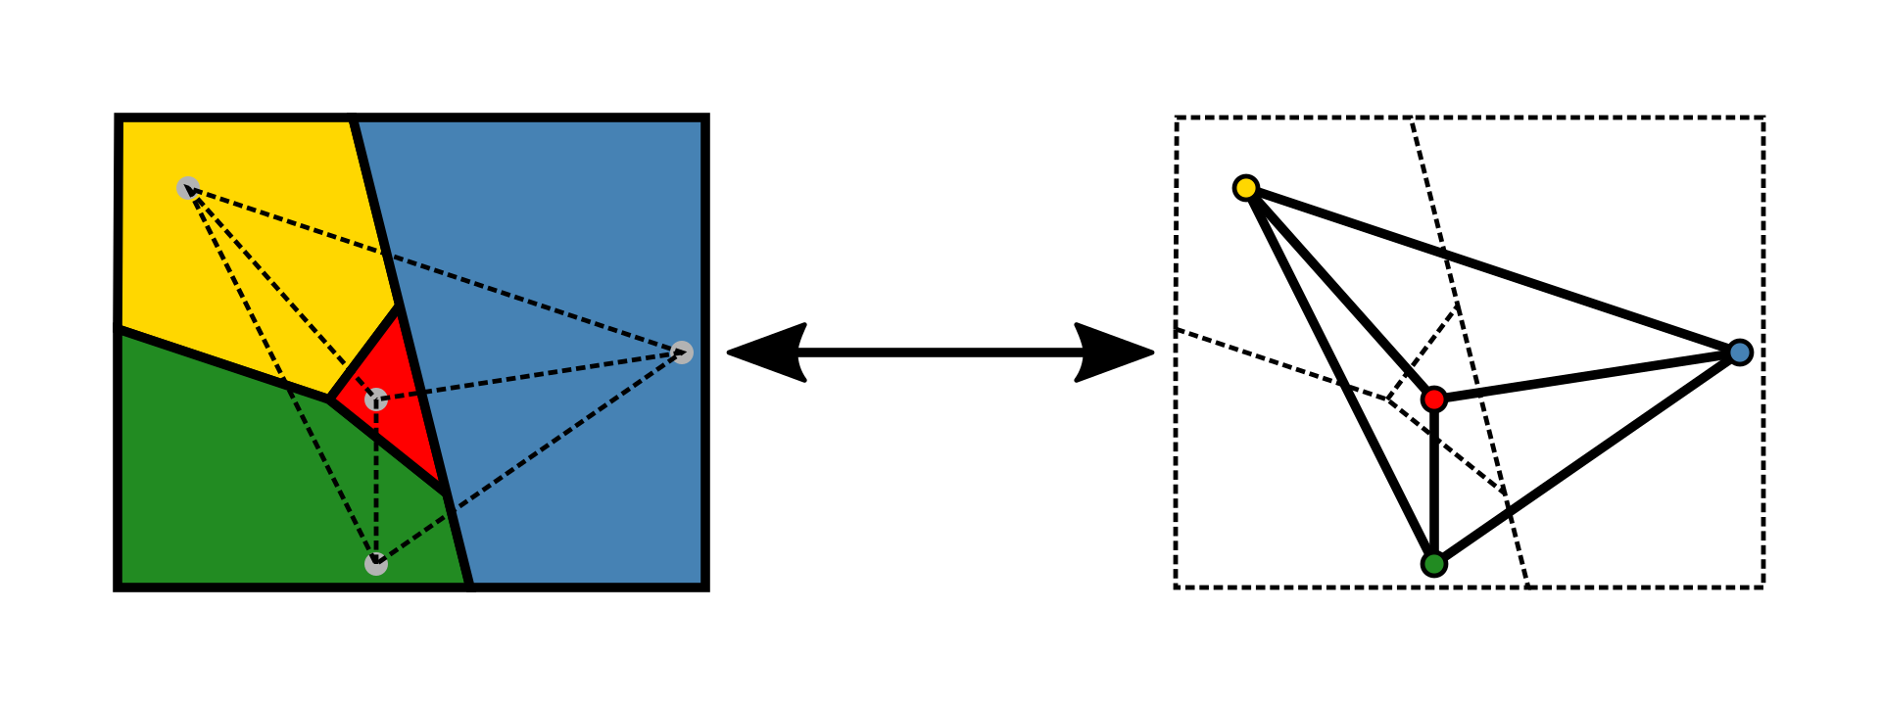
WHY NEEDS TOPOLOGY -Four color theorem (Fyrfärgssatsen)
A map with four regions, and the corresponding planar graph with four vertices.
1
1
1
2
2
1
1
2
1
1
2
1
1
2
1
1
3
2
3
2
3
3

Slide 13
WHY NEEDS TOPOLOGY -Four color theorem (Fyrfärgssatsen)
4
4
4
5
5
4
5
4
4
2
1
2
1
1
2
6
1
1
1
6
3
3
2
3
2
2
3
3
3
6
2
2
1
1
5
1
4
5
1
4
3
4
4
6
3
2
6
3
3
2
Could you please find the 5th different point connecting all of another 4 points with lines but lines should not be crossed over in 2D domain?

Slide 14
WHY NEEDS TOPOLOGY -Four color theorem (Fyrfärgssatsen)
2
2
1
5
1
1
1
4
4
3
4
5
6
4
2
3
3
6
3
2

Slide 15
EULER CHARACTERISTIC
Polyhedron formula: V − E + F = 2 (by Leonhard Euler)
Tetrahedron
Hexahedron or cube
Octahedron
Dodecahedron
Icosahedron

Slide 16
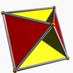
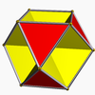
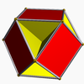
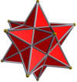
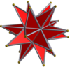
EULER CHARACTERISTIC
Name | Image | Vertices V | Edges E | Faces F | Euler characteristic: V − E + F
Tetrahemihexahedron |  | 6 | 12 | 7 | 1
Octahemioctahedron |  | 12 | 24 | 12 | 0
Cubohemioctahedron |  | 12 | 24 | 10 | −2
Small stellated dodecahedron |  | 12 | 30 | 12 | −6
Great stellated dodecahedron |  | 20 | 30 | 12 | 2

Slide 17
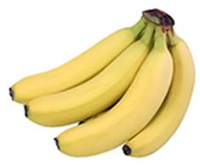
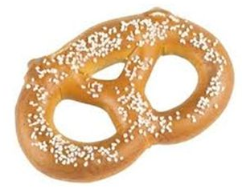
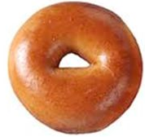
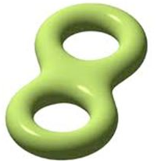
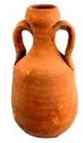
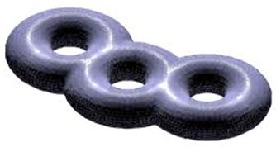
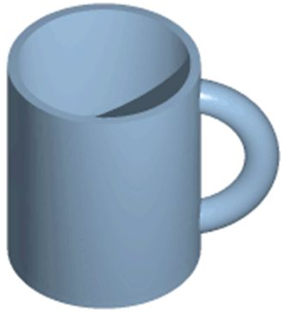
IN-DEPTH - WHY TO GROUP THEM LIKE THAT?
Which surfaces are topologically the same?

Slide 18
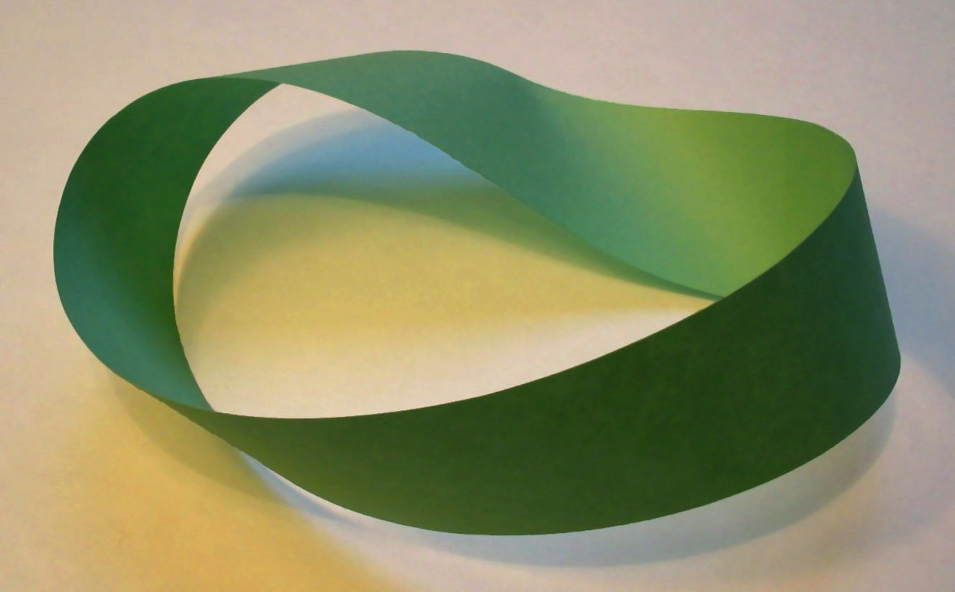
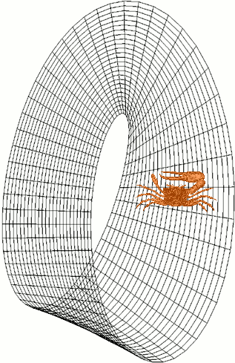
IN-DEPTH - Möbius strip (Möbiusband)
In mathematics, a Möbius strip, band, or loop , also spelled Mobius or Moebius, is a surface with only one side (when embedded in three-dimensional Euclidean space) and only one boundary curve. The Möbius strip is the simplest non-orientable surface. It can be realized as a ruled surface. Its discovery is attributed independently to the German mathematicians Johann Benedict Listing and August Ferdinand Möbius in 1858, though similar structures can be seen in Roman mosaics c. 200–250 AD. Möbius published his results in his articles "Theorie der elementaren Verwandtschaft" (1863) and "Ueber die Bestimmung des Inhaltes eines Polyëders" (1865).
A Möbius strip made with a piece of paper and tape. If its full length were crawled by a crab, the crab would return to its starting point having traversed both sides of the paper without ever crossing an edge. this fiddler crab's larger claw switches between left to right with every circulation. It is not impossible that the universe may have this property

Slide 19
IN-DEPTH - Möbius strip (Möbiusband)

Slide 20
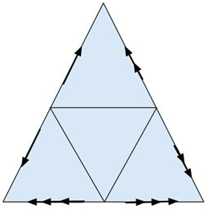
IN-DEPTH - Gluing diagrams
What topological surface do you get when you glue (or tape) the edges of the triangle together as shown?

Slide 21
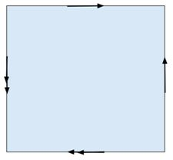
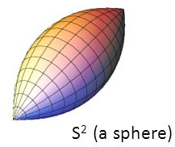
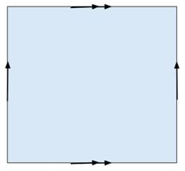
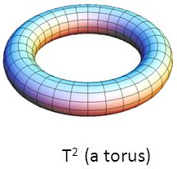
IN-DEPTH - Gluing diagrams

Slide 22
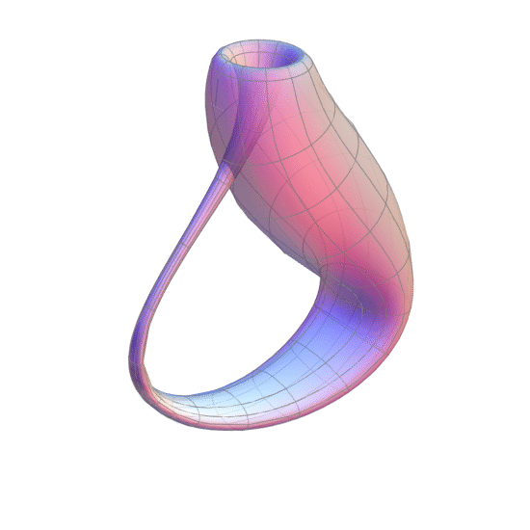
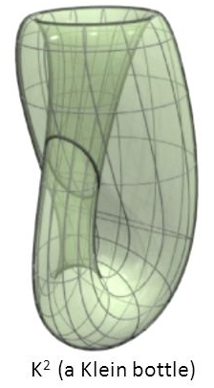
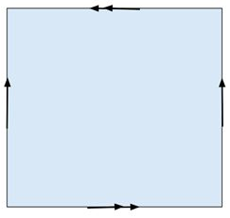
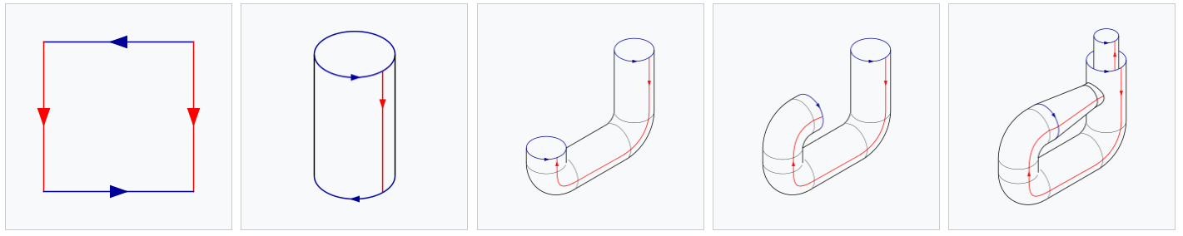
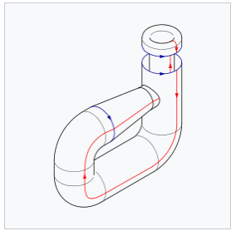
IN-DEPTH - Gluing diagrams
What surface do you get when you glue together the sides of the square as shown?

Slide 23
IN-DEPTH - SUMMERIZATION

Slide 24
IN-DEPTH - SUMMERIZATION

Slide 25

IN-DEPTH - Life inside the surface of a torus
What happens as this 2-dimensional creature travels through its tiny torus universe?
What does it see when it looks forward? Backward? Left? Right?

Slide 26
IN-DEPTH - Life in a Klein bottle surface
What happens as this 2-dimensional creature travels through its tiny Klein bottle universe?
A path that brings a traveler back to his starting point mirror-reversed is called an orientation-reversing path.
A surface that contains an orientation-reversing path is called non-orientable. What happens as this creature travels through its Klein bottle universe?

Slide 27
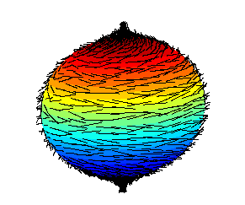
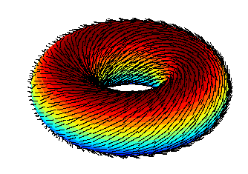
IN-DEPTH - Hairy ball theorem (Igelkottsteoremet)
The hairy ball theorem of algebraic topology (sometimes called the hedgehog theorem in Europe) states that there is no nonvanishing continuous tangent vector field on even-dimensional n-spheres. For the ordinary sphere, or 2‑sphere, if f is a continuous function that assigns a vector in R³ to every point p on a sphere such that f(p) is always tangent to the sphere at p, then there is at least one pole, a point where the field vanishes (a p such that f(p) = 0).
A failed attempt to comb a hairy 3-ball (2-sphere), leaving a tuft at each pole
A hairy doughnut (2-torus), on the other hand, is quite easily comfortable.

Slide 28
IN-DEPTH - Hairy ball theorem (Igelkottsteoremet)

Slide 29


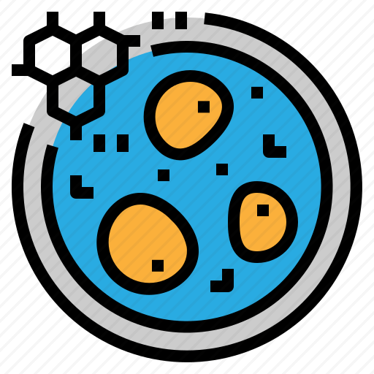




ZOOM OUT
Robotics
Biology: molecules and nanostructure
Applications
Computer science and network
Physics
Topics: General topology, Algebraic topology, Differential topology, Geometric topology, Generalizations.
Concepts: Topologies on sets, Continuous functions and homeomorphisms, Manifolds.
Topology only has global structure, and studies more general properties, e.g, connectivity and more.
Homeomorphism / Homotopy equivalence
continuous deformations, such as stretching, twisting, crumpling, and bending; that is, without closing holes, opening holes, tearing, gluing, or passing through itself.
Geometry focuses on the detailed forms or structures properties, e.g, surface area, volume, and more.

Slide 30
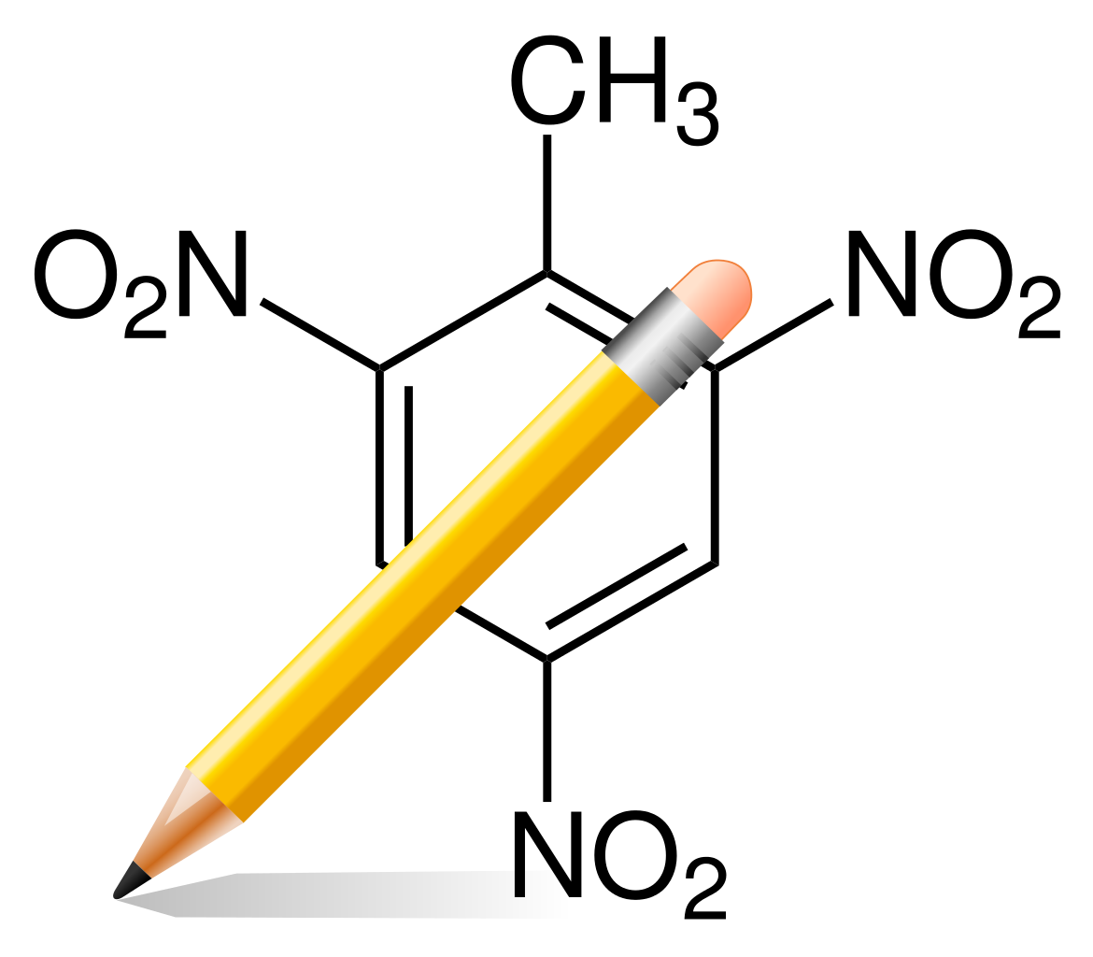


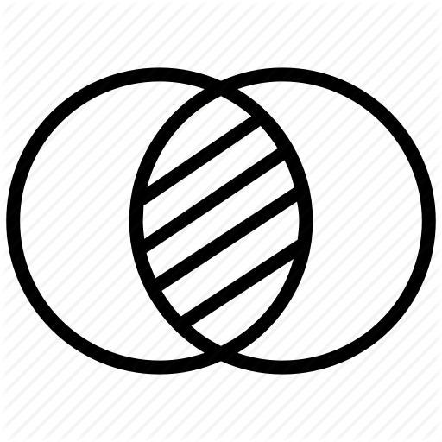
ZOOM OUT
Robotics
Chemics
Biology: molecules and nanostructure
Physics
Topology
Algebraic
Discrete mathematics
Computer science and network
Set theory
Geometry
Mathematics
This Photo by Unknown Author is licensed under CC BY-SA

Slide 31


Questions and Answers

